Slide 1


Oscar Mendez
May 5, 2024

Slide 2

Outline
Executive Summary
Introduction
Methodology
Results
Conclusion
Appendix

Slide 3
Executive Summary
Summary of methodologies
-Data Collected through API
-Data Collected with API Web Scraping
-Data Wrangling
-Exploratory Data Analysis with SQL
-Exploratory Analysis with Data Visualization
-Visual Analysis with Folium
-ML Predictions
Summary of all results
-Results of the EDA
-Screenshot of analysis
-Predictions of the ML Analysis

Slide 4
Introduction
Project background and context
- SpaceX advertises Falcon 9 rocket launches on its website with a cost of 62 million dollars; other providers cost upward of 165 million dollars each, much of the savings is because SpaceX can reuse the first stage. Therefore if we can determine if the first stage will land, we can determine the cost of a launch.
Problems you want to find answers
-Factors for a successfully landing
-Various factors that can change the course of the landings
-How we can minimize fails or predict successful landings

Slide 5

Section 1

Slide 6
Methodology
Executive Summary
Data collection methodology:
Data was collected via SpaceX API and API Web Scraping from Wikipedia
Perform data wrangling
Transform data into a more useful format to analysis
Perform exploratory data analysis (EDA) using visualization and SQL
Perform interactive visual analytics using Folium and Plotly Dash
Perform predictive analysis using classification models
How to build, tune, evaluate classification models
Categorize data based on historical information

Slide 7
Data Collection
The data was collected on methods commonly used on methods to us to be able to answer research questions, test hypotheses, and evaluate outcomes
Data collection was made via SpaceX API
We turn the data collected to the API (Json file) to a DataFrame on Pandas for better EDA
Webscrapring from wikipedia for us to be able to collect meaningful information with BeautifulSoup
Clean our data and remove empty values or columns not necessary for the EDA
Convert the scrap data to a DataFrame for better analysis

Slide 8
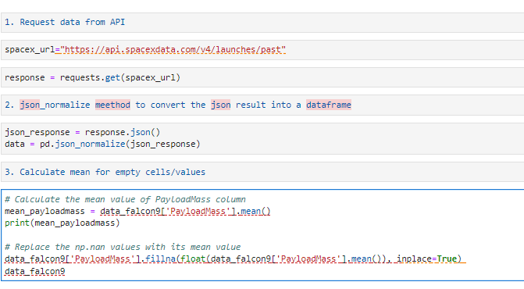
Data Collection – SpaceX API
We us the SpaceX API to collected the data, an normalize json file and remove the empty cells with data that we can work with and apply format.
Add the GitHub URL of the completed SpaceX API calls notebook (must include completed code cell and outcome cell), as an external reference and peer-review purpose

Slide 9
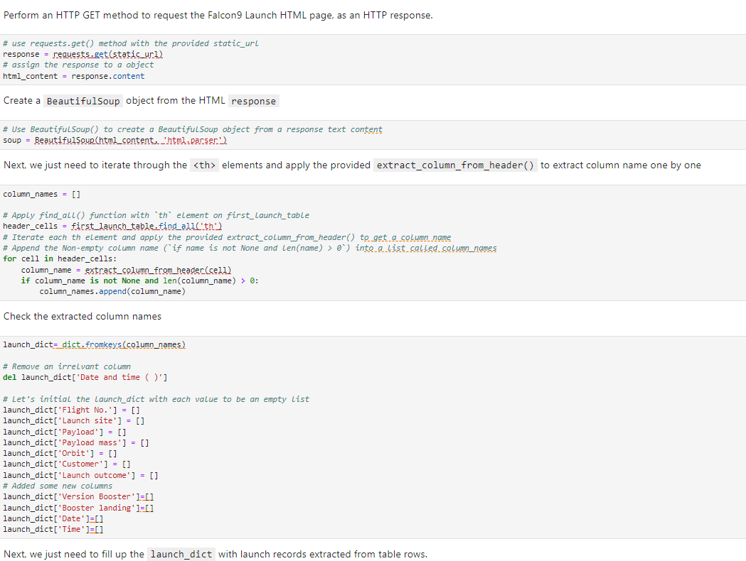
Data Collection - Scraping
We have apply WebScrapping with BeautifulSoup to Wikipedia.
Converted to Pandas DataFrame
Add the GitHub URL of the completed web scraping notebook, as an external reference and peer-review purpose

Slide 10

Data Wrangling
We apply exploratory data analyst to our data for us to be able to determine of best data for our model
Calculation was made per site of launch
Create a landing outcome label from the column outcome and save the results on csv.
Add the GitHub URL of your completed data wrangling related notebooks, as an external reference and peer-review purpose

Slide 11
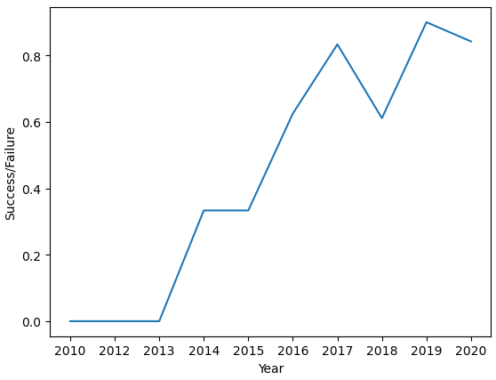
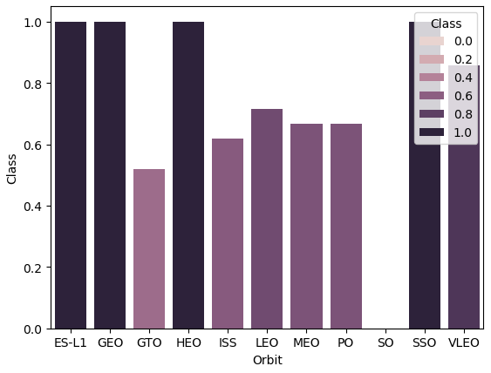
EDA with Data Visualization
We summarize the analysis with variable and different relationship
Add the GitHub URL of your completed EDA with data visualization notebook, as an external reference and peer-review purpose

Slide 12
EDA with SQL
We load the SpaceX data to our SQLite Magic command on Jupyter Notebook, and make our data analysis.
We run our magic commands to run queries and find valuable data
Display the names of the site launches for the Falcon 9
Summatory of the Payload Mass from the NASA (CSR)
List total of success/failure launch missions
Landing outcomes such as Failure drone ship or Success ground pad
Add the GitHub URL of your completed EDA with SQL notebook, as an external reference and peer-review purpose

Slide 13
Build an Interactive Map with Folium
I’ve mark and the launches sites with their marker, circle and lines to mark the success or failure of the landings.
Identify by color the launching sites with the success and fail with the marker clusters.
Calculation of the distance between the railways, highways and coastlines.
Notice why is important the surrounding of the launch sites.
Add the GitHub URL of your completed interactive map with Folium map, as an external reference and peer-review purpose

Slide 14
Build a Dashboard with Plotly Dash
•We built an interactive dashboard with Plotly dash
•We plotted pie charts showing the total launches by a certain sites
•We plotted scatter graph showing the relationship with Outcome and Payload Mass (Kg) for the different booster version.
Add the GitHub URL of your completed Plotly Dash lab, as an external reference and peer-review purpose

Slide 15
Predictive Analysis (Classification)
We loaded the data using numpy and pandas, transformed the data, split our data into training and testing.
We built different machine learning models and tune different hyperparameters using GridSearchCV.
We used accuracy as the metric for our model, improved the model using feature engineering and algorithm tuning.
We found the best performing classification model.
Add the GitHub URL of your completed predictive analysis lab, as an external reference and peer-review purpose

Slide 16
Results
Exploratory data analysis results
Interactive analytics demo in screenshots
Predictive analysis results

Slide 17

Section 2

Slide 18
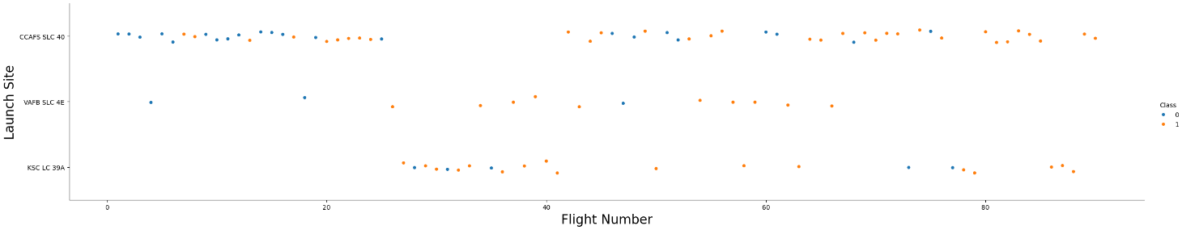
Flight Number vs. Launch Site
The VAFB SLC 4E and KSC LC 39A has better success rate

Slide 19
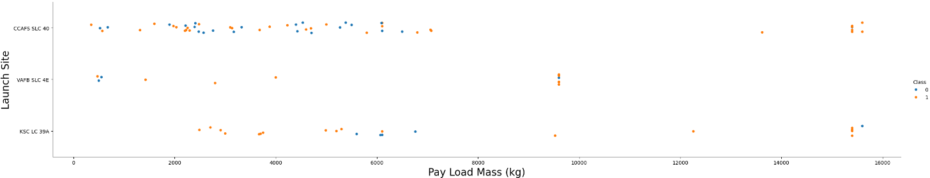
Payload vs. Launch Site
More Payload Mass (Kg) has a higher success rate.

Slide 20
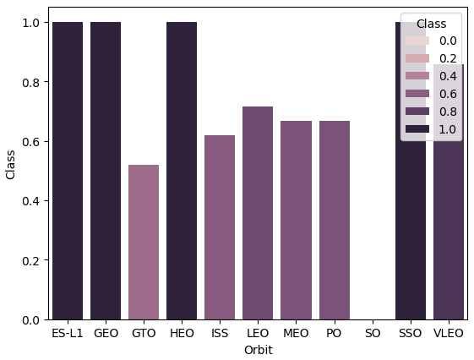
Success Rate vs. Orbit Type
The orbits ES-L1, GEO, SSO and VLEO had the best success rate

Slide 21
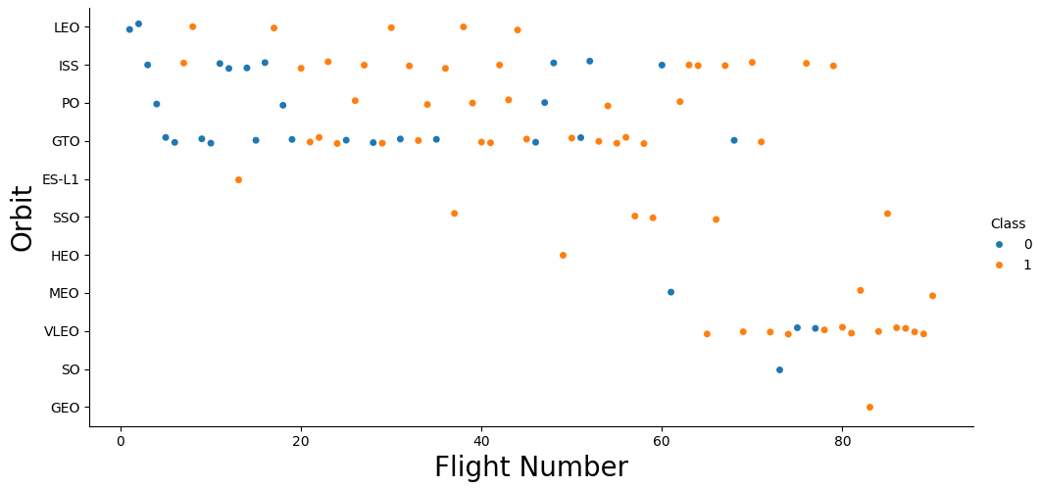
Flight Number vs. Orbit Type
You should see that in the LEO orbit the Success appears related to the number of flights; on the other hand, there seems to be no relationship between flight number when in GTO orbit.

Slide 22
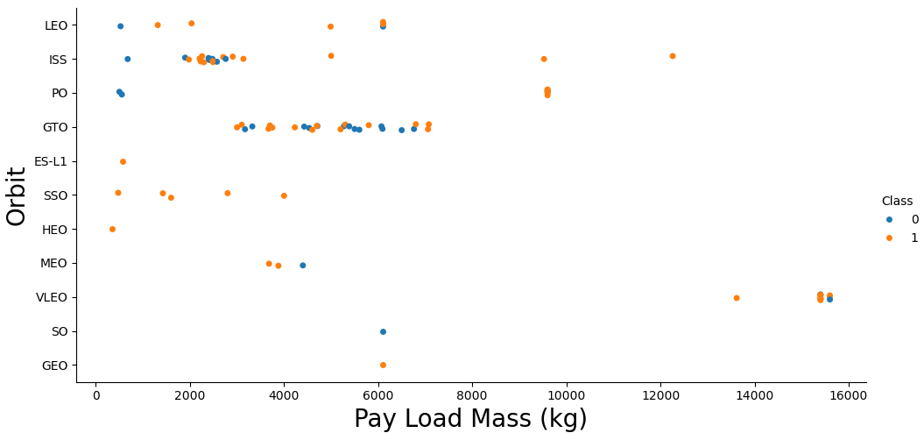
Payload vs. Orbit Type
With heavy payloads the successful landing or positive landing rate are more for Polar,LEO and ISS. However for GTO we cannot distinguish this well as both positive landing rate and negative landing(unsuccessful mission) are both there here.

Slide 23
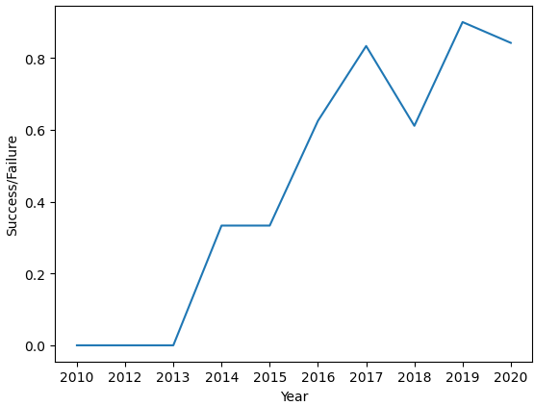
Launch Success Yearly Trend
Over the years since 2013 the success has been increasing

Slide 24
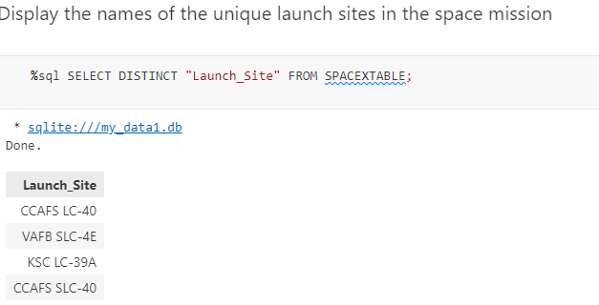
All Launch Site Names
Below shows the magic command to find the unique launch sites

Slide 25
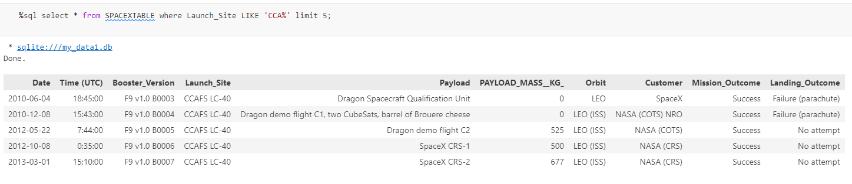
Launch Site Names Begin with 'CCA'
We can see the below magic command for us to be able to query all the launch sites from the column “Launch_Site” that the name start with ‘CCA’

Slide 26
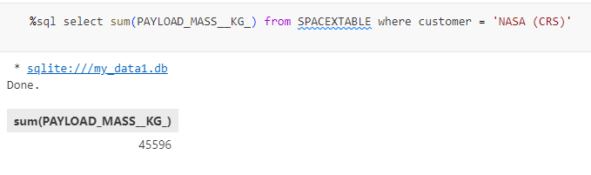
Total Payload Mass
Calculate the total sumatory for the Payload Mass on KG from all the customers with the word ‘NASA (CRS)’

Slide 27
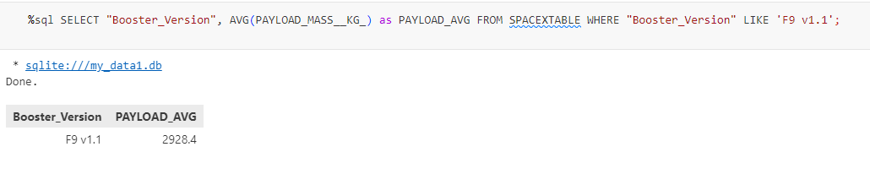
Average Payload Mass by F9 v1.1
Below is the average payload mass on kg from the booster version F9 v1.1

Slide 28
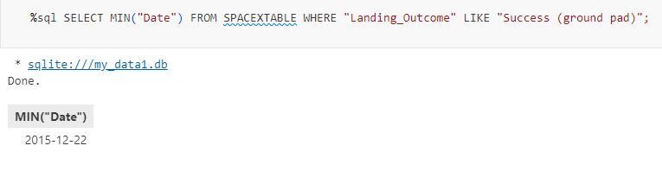
First Successful Ground Landing Date
Below is the dates of the first successful landing outcome on ground pad

Slide 29
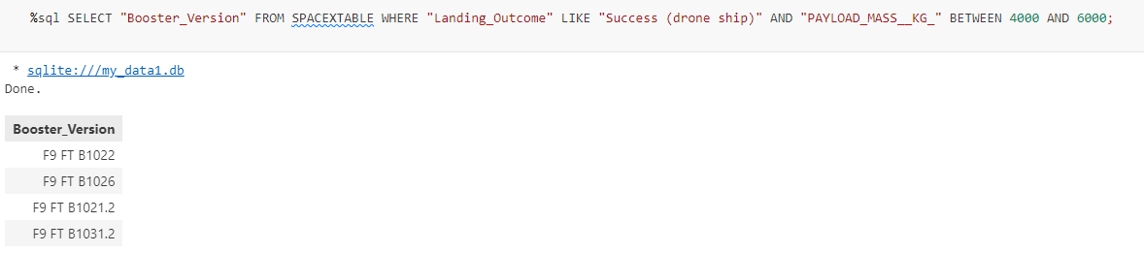
Successful Drone Ship Landing with Payload between 4000 and 6000
Names of boosters which have successfully landed on drone ship and had payload mass greater than 4000 but less than 6000

Slide 30
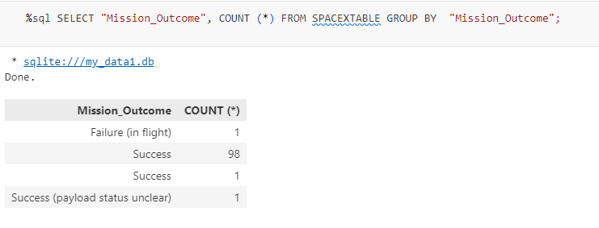
Total Number of Successful and Failure Mission Outcomes
Calculation of the total number of successful and failure mission outcomes with magic commands

Slide 31
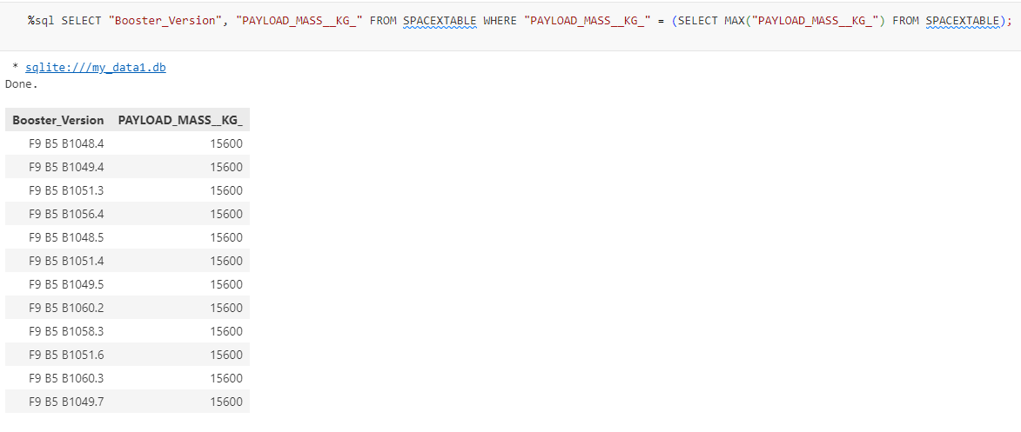
Boosters Carried Maximum Payload
Names of the booster which have carried the maximum payload mass

Slide 32
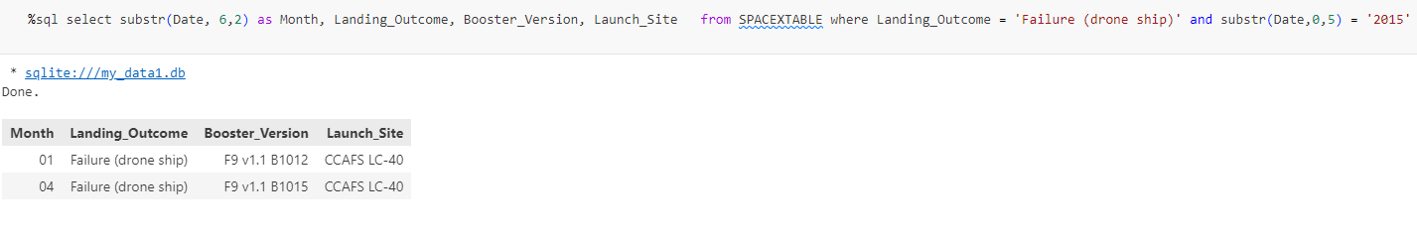
2015 Launch Records
List of the failed landing_outcomes in drone ship, their booster versions, and launch site names for in year 2015

Slide 33
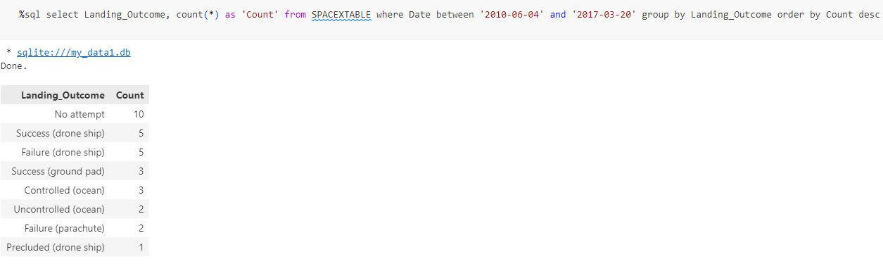
Rank Landing Outcomes Between 2010-06-04 and 2017-03-20
Count of landing outcomes (such as Failure (drone ship) or Success (ground pad)) between the date 2010-06-04 and 2017-03-20, in descending order

Slide 34

Section 3

Slide 35
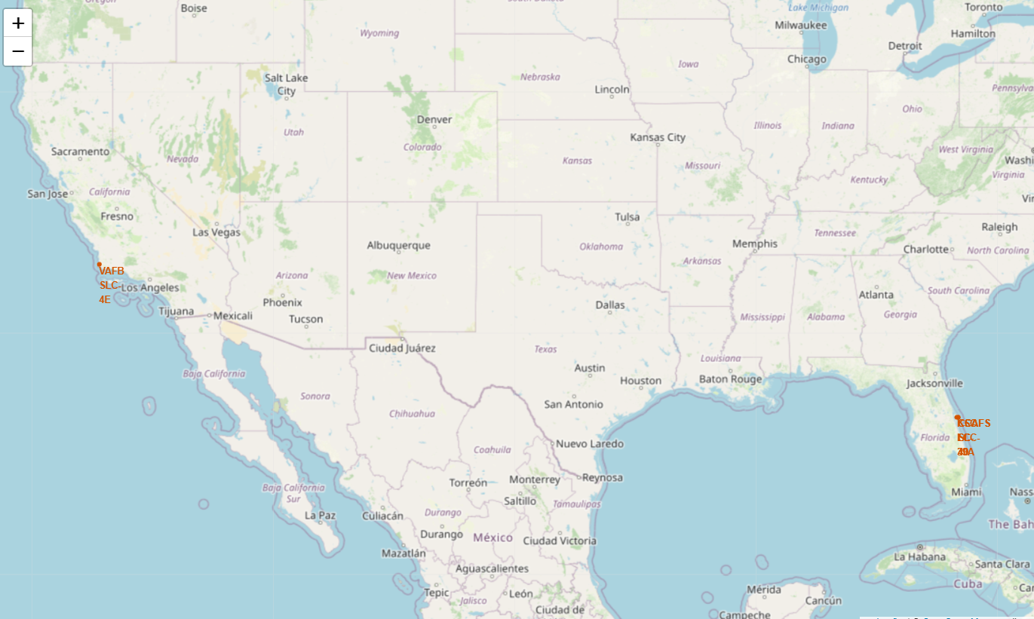
Launch Locations (Folium)
One of the benefits of being close to the Equator line is the extra speed boost from the Earth's rotation saves on fuel that would be used to help the rocket achieve the proper speed

Slide 36
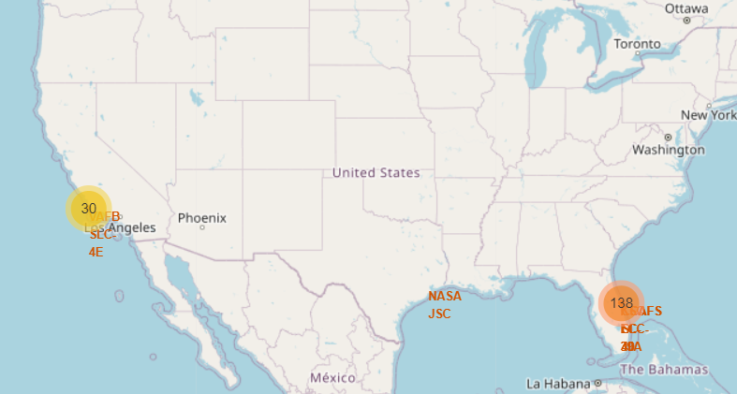
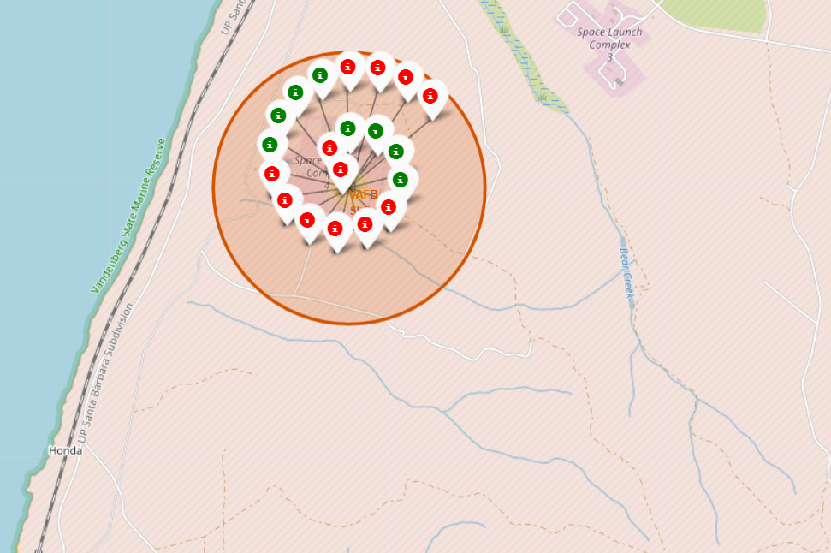
Success vs Fail
Color Code the success launches and fail for better reference

Slide 37
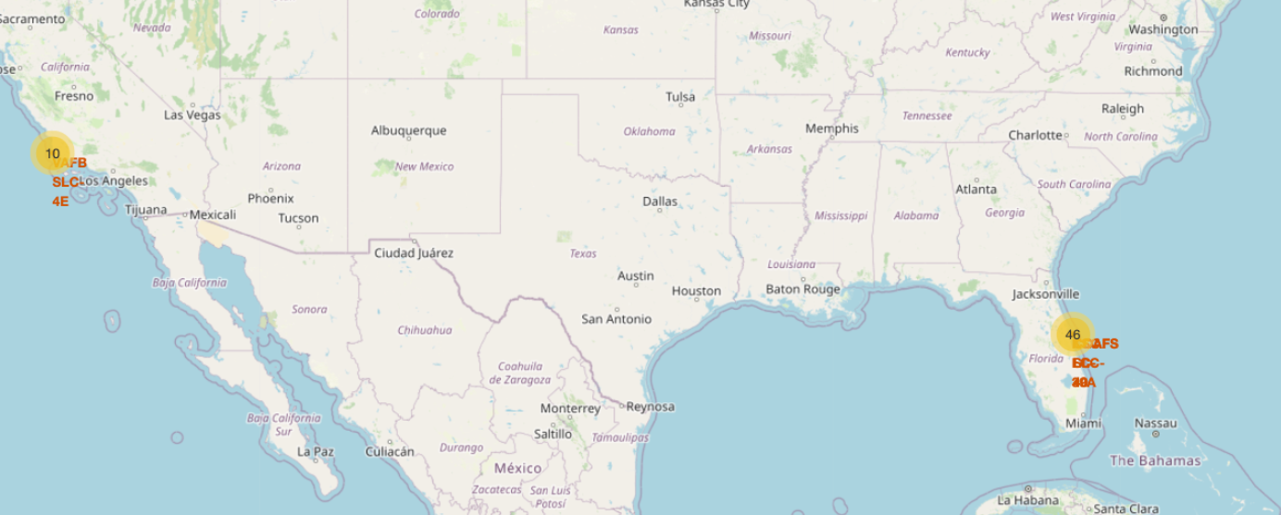
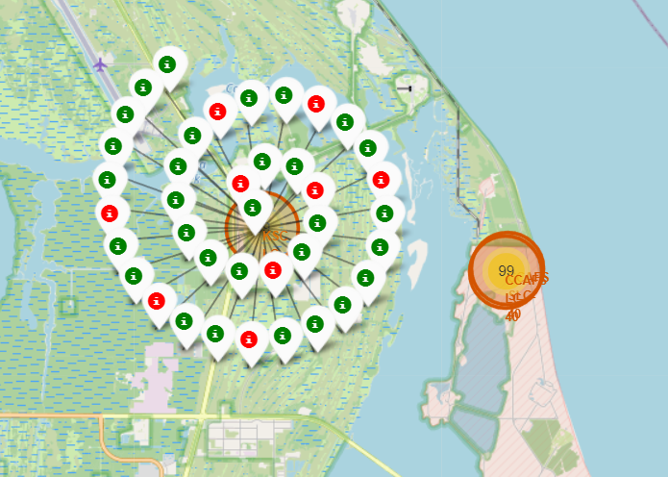
Importance of different transportation and secure methods
it is really important to be close to the railways, highways for easy transportation of parts or materials, and be as far of the cities for avoid casualties or bigger lost

Slide 38

Section 4

Slide 39
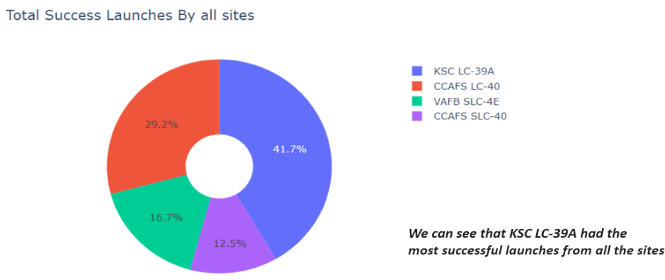
Pie chart showing the success percentage achieved by each launch site

Slide 40
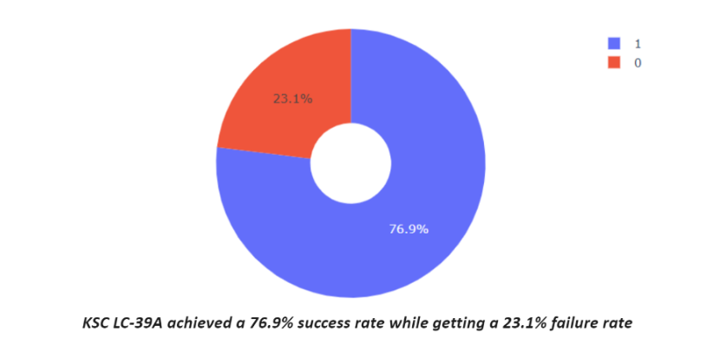
Pie chart showing the Launch site with the highest launch success ratio

Slide 41
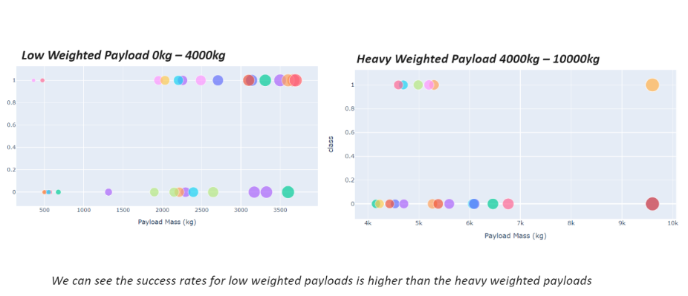
Scatter plot of Payload vs Launch Outcome for all sites, with different payload selected in the range slider
Replace <Dashboard screenshot 3> title with an appropriate title
Show screenshots of Payload vs. Launch Outcome scatter plot for all sites, with different payload selected in the range slider
Explain the important elements and findings on the screenshot, such as which payload range or booster version have the largest success rate, etc.

Slide 42

Section 5

Slide 43
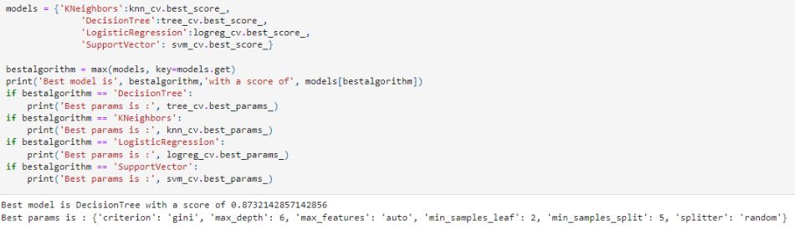
Classification Accuracy
The decision tree classifier is the model with the highest classification accuracy

Slide 44
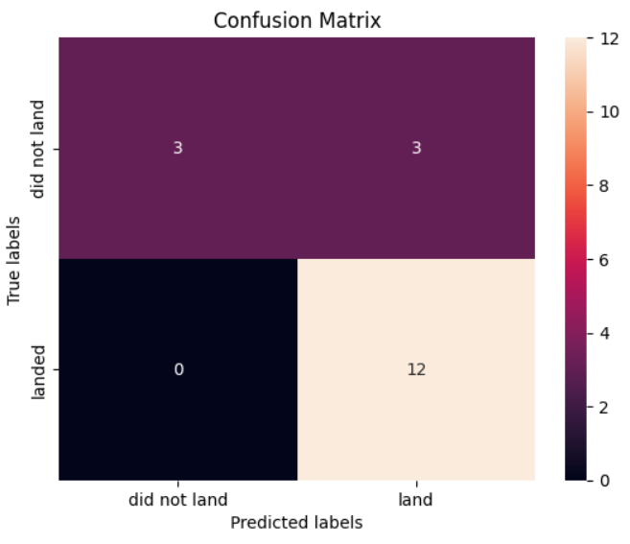
Confusion Matrix
The confusion matrix for the decision tree classifier shows that the classifier can distinguish between the different classes. The major problem is the false positives. i.e., unsuccessful landing marked as successful landing by the classifier.

Slide 45
Conclusions
We can conclude that:
The larger the flight amount at a launch site, the greater the success rate at a launch site.
Launch success rate started to increase in 2013 till 2020.
Orbits ES-L1, GEO, HEO, SSO, VLEO had the most success rate.
KSC LC-39A had the most successful launches of any sites.
The Decision tree classifier is the best machine learning algorithm for this task.

Slide 46


